Slide 1
Presentation on the Mopani Copper Mines Transaction
Investing SMARTLY
23rd February 2024
Virtual/Mulungushi Conference Centre KK Wing, Lusaka

Slide 2
Presentation outline
Key highlights
Overview of the Strategic Equity Partner
Transaction overview
Post-transaction benefits
Financial effects for ZCCM-IH
Final steps to closing
Notes:
Key highlights of the transaction
Transaction rationale
Overall timeline and historical overview of the transaction
Font size 14

Slide 3
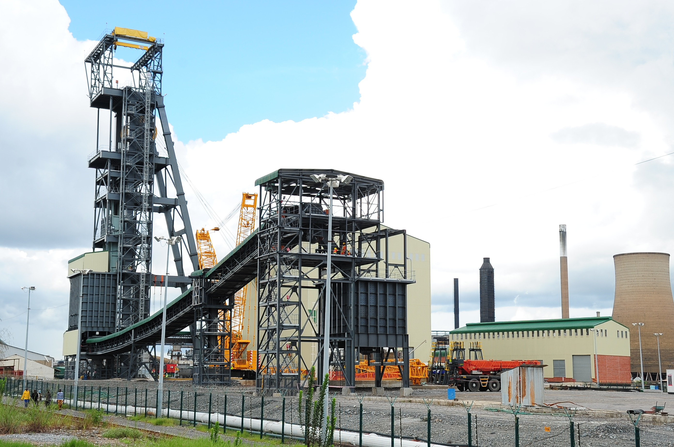
1 | Key highlights

Slide 4
Key highlights
Overview | Delta Mining Limited (“Delta”), a subsidiary of International Resource Holdings (“IRH”), has agreed to acquire a 51% shareholding in Mopani Copper Mines (“MCM”) for a total investment of up to US$1.1 billion
Use of proceeds | Delta’s up to US$1.1 billion investment is comprised of: US$620 million of new equity to fund short-term liquidity and capital expansion projects A US$400 million loan which will be paid to Glencore to settle Glencore’s US$1.8bn debt After Closing, MCM’s debt position will reduce by US$1.4 billion Up to US$88 million which may be made available to MCM as shareholder loans, if required, to fund future working capital
Other salient features | The GRZ will continue to own a special share in MCM, holding several key rights The existing offtake agreement with Glencore will be terminated and replaced with a new offtake agreement with Delta In addition to the US$400m, Glencore will receive the following in lieu of the US$1.8bn debt: a 10% price differential royalty from Mopani for the period 2027 to 2036 only if the copper price exceeds US$12k/ton a US$150m structured payment payable over a 5-year period
Notes:
Key highlights of the transaction
Transaction rationale
Overall timeline and historical overview of the transaction
Font size 14

Slide 5
Transaction Rationale
✓
Provides an injection of US$620m for MCM’s working capital and capital expansion projects
✓
Restructures the MCM balance sheet and eliminates the existing Glencore debt burden
✓
Introduces new skills and expertise from Delta that will facilitate the expansion of MCM production to 200k+ tonnes pa
✓
Provides ZCCM-IH with a long-term partner and commitment to maintaining the existing labour force at MCM
✓
Ensures the long-term sustainability of MCM, which contributes to the revitalisation of the Copperbelt
Notes:
Key highlights of the transaction
Transaction rationale
Overall timeline and historical overview of the transaction
Font size 14

Slide 6
ZCCM-IH VISION & MISSON
2 | Overview of the Strategic Equity Partner

Slide 7
IRH group structure and business verticals
IRH, a subsidiary of International Holding Company (“IHC”), operates through six business verticals across the mining value chain. The MCM investment will be held by Delta
Group structure
Business verticals
International Holding Company
(Listed on ADX)
Market cap: US$238bn²
Other shareholders and minority investors
3
Geo & Tech
Trading
Mining
2
1
Mining operations and solutions
Mineral exploration
Purchase and sale of commodities
78%¹
22%¹
International Resources Holding (Abu Dhabi)
6
Refining
Logistics
4
5
Ventures
Processing and refining of raw materials
Private early-stage company investments
End-to-end logistics solutions
100%
Delta Mining Limited (Abu Dhabi)
Notes: (1) Simplified group structure representing the effective shareholding of IHC and all other entities invested in IRH
(2) Converted using USD/AED of 3.67 spot rate as of 13 February 2024

Slide 8
Overview of IHC
International Holding Company (“IHC”) is an Abu-Dhabi based conglomerate investing in high-growth companies across various countries and sectors
About IHC
Investment portfolio
Focused on building a global ecosystem that fosters growth opportunities, technology and innovation for shareholders
Over 400 subsidiaries with a geographical presence in 20+ countries (Middle East, Africa, Asia, Europe, North and South America)
Strategy to enhance its portfolio through acquisitions and strategic investments
IHC is controlled by the Royal Group, with Sheikh Tahnoon bin Zayed al-Nahyan (a member of the Abu Dhabi royal family) as the Chairman
Investment strategy is aligned with ‘Abu Dhabi’s Economic Vision 2030’ and the UAE’s ‘Next 50’ development plans
Makes strategic investments and / or enters partnerships across various sectors (i.e. real estate, consumer and retail, mining, energy and utilities, etc.)
Listed and unlisted investments, joint ventures and partnerships include:
IHC has a market cap of US$238 billion¹
Notes: (1) Converted using USD/AED of 3.67 spot rate as of 13 February 2024

Slide 9
Overview of IRH, a subsidiary of IHC
International Resources Holding (“IRH”) is a subsidiary of IHC with a portfolio of diverse assets in natural resources
About IRH
Core values
Dynamic conglomerate focused on unlocking the mineral value chain across Africa and beyond
Specialises in energy transition minerals such as Copper, Cobalt, Nickel, Lithium, 3T (Tin, Tantalum & Tungsten), Manganese and Graphite
Integrity
Safety
Value proposition
Innovation
Operating across the entire mining value chain, offering comprehensive end-to-end solutions
Forming strategic national government partnerships and delivering integrated value chains
Maximising value for all stakeholders while minimising environmental impact
Community engagement
Environmental stewardship

Slide 10
ZCCM-IH VISION & MISSON
3 | Transaction overview

Slide 11
Transaction overview
Total debt reduced from US$1.8bn to c.US$536m
Pre-transaction
Post-transaction
ZCCM-IH
ZCCM-IH
Delta
(US$620m)
GRZ
1 special share
100%
49%
51%
Glencore offtake
Royalty
Delta offtake
Delta
US$400m loans + up to c.$88m² in shareholder loans
ZCCM-IH
US$107m super senior¹
Glencore
US$1.69bn debt¹+ US$100m super senior
Glencore
US$1.69bn debt¹+ US$100m super senior
ZCCM-IH
c.US$88m shareholder loan
3rd party banks
US$48m of credit facilities
3rd party banks
US$48m of credit facilities
Notes: (1) Includes accrued interest to Glencore and to ZCCM-IH
(2) To match the ZCCM-IH loan at close
Key: Equity-like Debt-like Offtake Glencore offer

Slide 12
Settlement of Glencore debt of US$1.8bn
In lieu of Glencore writing down c. US$1,236 million in debt, it has been agreed that Glencore will receive:
US$400 million cash payment on close of the Transaction by IHC
a deferred payment of $150 million by ZCCM-IH to be paid over 5 years
a 10% price differential royalty from Mopani only if the copper price exceeds US$12,000 per ton over the period 2027-2036

Slide 13
Key financial terms
US$620m
Equity component
US$220m is payable at closing;
US$130m already advanced via interim financing shall convert into equity
US$19m will be used to repay a portion of ZCCM-IH’s shareholder loan
The remaining US$71m will be used as working capital
US$400m will be allocated towards funding MCM’s project development plan and is payable as and when the funding is required
US$400m
Loan component
On closing, Delta will provide MCM with a loan of US$400m which will be used to settle all existing Glencore debt (2021 transaction debt and LCs)
The net result is a reduction in MCM’s debt burden by US$1.4bn
ZCCM-IH’s guarantee over Glencore’s debt is released
Further loans of up to US$88m may be made available to MCM as shareholder loans, if required, based on the future working capital requirements

Slide 14
Overview of funding provided by IRH
Description of Funding | Amount (US$m)
Interim funding already advanced by IRH | 130
Equity payable at closing | 90
Total equity at closing | 220
Equity capital for expansion projects | 400
Total equity provided | 620
Further shareholder loans (if required) | 88
Total loans to settle Glencore Debt | 400
Total funding provided | 1,108

Slide 15
Impact on the MCM balance sheet
MCM’s debt burden to reduce by US$1.4 billion
US$1,941m
Less US$1,786m
ZCCM-IH
Banks
GIAG LC
Repayment
Deferred payment (see next slide)
GIAG
Write down
Plus US$400m¹
Net total: c.US$536m¹
Less US$19m
ZCCM-IH
Banks
Delta
Source: MCM Accounts as at 31 December 2023
Note: (1) Actual amount may differ, subject to outstanding balance of Glencore LC facility at date of Completion

Slide 16
ZCCM-IH VISION & MISSON
4 | Post-Transaction benefits

Slide 17
Benefits of the transaction
The investment by Delta represents a significant milestone in the history of MCM and the development of the Copperbelt, establishing a new strategic partnership
Financial strength of the SEP and MCM | Recapitalisation of MCM’s balance sheet and expansion of production Significant increase in shareholder value with potential future dividend ZCCM-IH will hold a 49% stake in MCM, with a staggered dividend from initially 30/70 to 49/51 over time
Long-term sustainability | New capital will enable MCM to increase production to c.200ktpa Secures the economic sustainability of MCM driving direct and indirect employment An ongoing commitment to invest in CSI initiatives IRH have made a commitment to maintain MCM’s labour force
Revitalisation of the Zambian economy | Extended longevity of MCM will contribute to the revitalisation of the Copperbelt and the Zambian economy Increased tax receipts and the promotion of supplier development
Participation of the mining value chain | Commitment by IRH to local procurement and supplier development Potential for investment in adjacent industries and other minerals
Partnership | Long-term partnership with IRH
1
2
3
4
5

Slide 18
ZCCM-IH VISION & MISSON
5 | Financial effects for ZCCM-IH

Slide 19
Financial effects of the transaction
Significantly improved financial performance for ZCCM-IH’s shareholders
Line item | Before | Pro Forma Adjustments | After | % change
EPS (ZMW) | (23.54) | 92.37 | 68.83 | 392.4%
HEPS (ZMW) | (23.54) | 55.27 | 31.72 | 234.8%
NAV per share (ZMW) | 49.18 | 94.23 | 143.42 | 191.6%
Ordinary Shares in issue | 160,800 | - | 160,800 | 0.0%
Shares in issue | 160,800 | - | 160,800 | 0.0%
Weighted average # of Ordinary Shares in issue | 160,800 | - | 160,800 | 0.0%

Slide 20
ZCCM-IH VISION & MISSON
6 | Final steps to closing

Slide 21
Final steps to closing
The transaction is expected to close latest 15 March 2024
Date | Key workstream
23 February | EGM held and EGM results published
29 February | Approval by Ministry of Mines and Mineral Development of the overall transaction and renewal of MCM’s Mining Licenses
29 February | SEC approval of change of control
1 March | Finalisation of Glencore documents, intragroup shareholder loans and the Shareholder Agreement
4 - 8 March | Target transaction completion and flow of funds
15 March | Long Stop Date for the completion of all Conditions Precedents
Q3 2024 | Obtain non-suspensory COMESA approval¹
Notes: (1) COMESA approval generally takes 3-5 months but is not a condition to Completion

Slide 22
Thank you

