Slide 1
SHAREHOLDER OPEN DAY
Virtual/Physical: Mulungushi International Conference Centre, Lusaka
28 October 2025
Investing SMARTLY
Notes:
The ZCCM-IH Board chairperson, the Vice Board Chairperson, and other ZCCM-IH Board Directors present, all ZCCM-IH shareholders present, allow me to simply say all protocol observed. Good morning.
I shall be presenting the key developments experienced by the company during the recent months

Slide 2
DISCLAIMER
This document, which has been issued by ZCCM-IH Plc (the “Company”), comprises the written materials/slides for a presentation concerning the Company, including its business, results of operations and prospects. This document does not constitute or form part of any offer or invitation to sell, issue or subscribe for, or any solicitation of any offer to purchase, sell or subscribe for, any shares in the Company in any jurisdiction nor may it or any part of it nor the fact of its distribution form the basis of, or be relied on in connection with, or to act as an inducement to enter into any contract or investment decision in relation thereto, nor does it constitute a recommendation regarding the shares of the Company. The contents of this presentation are to be kept confidential.
This document is being made available for information purposes only and the information in this document reflects prevailing conditions and or judgment as at the date of this document.
No reliance may be placed for any purposes whatsoever on the information contained in this document or on its completeness accuracy or fairness. No representation or warranty, express or implied, is given by or on behalf of the Company, its shareholders, as to the accuracy or completeness of the information or opinions contained in this presentation. None of the Company, its shareholders or any of its affiliates, advisors or representatives shall, have any liability whatsoever (in negligence or otherwise) for any loss whatsoever arising from any use of this document, or its contents, or otherwise arising in connection with this document, save in the case of fraud. This document and its contents are confidential and may not be reproduced, redistributed or passed on, directly or indirectly, to any other person or published, in whole or in part, for any purpose.
Certain statements in this presentation, or given in response to questions, may constitute forward-looking statements. These statements relate to future events or future performance and reflect the Company’s expectations and assumptions regarding the growth, results of operations, performance and business prospects and opportunities of the Company. In particular, statements regarding the Company’s objectives, plans and goals involve forward-looking statements. We caution you that any forward-looking statements are just predictions. They are not guarantees of future performance and involve risks and uncertainties. A number of factors could cause actual events, performance or results to differ materially from what is projected in the forward-looking statements. Although the forward-looking statements contained in this discussion are based on what the Company considers to be reasonable assumptions based on information currently available to it, there can be no assurance that actual events, performance or results will be consistent with these forward-looking statements, and the Company’s assumptions may prove to be incorrect. The Company does not intend, and, subject to any legal or regulatory requirements, does not assume any obligation, to update or revise them to reflect new events or circumstances. You should not place undue reliance on forward looking statements which speak only at the date of this document.
Notes:
I will start the presentation with a disclaimer, the purpose of this presentation is to provide a general understanding of the business of the company , and not for investment decision , this presentation contains forward looking which is subject to know and unknown risk.

Slide 3
OUTLINE
1. STRATEGIC INVESTMENT DEVELOPMENT
2. FINANCIAL PERFORMANCE HIGHLIGHTS HY2025
3. STRATEGIC OUTLOOK
4. CORPORATE ACTIONS
6. QUESTIONS AND ANSWERS
5. STOCK MARKET PERFORMANCE
Notes:
Today’s agenda will cover the company’s performance highlights, updates on strategic projects such as Mopani and KCM, investment activities, financial results, strategic outlook and proposed dividend for 2024FY.

Slide 4
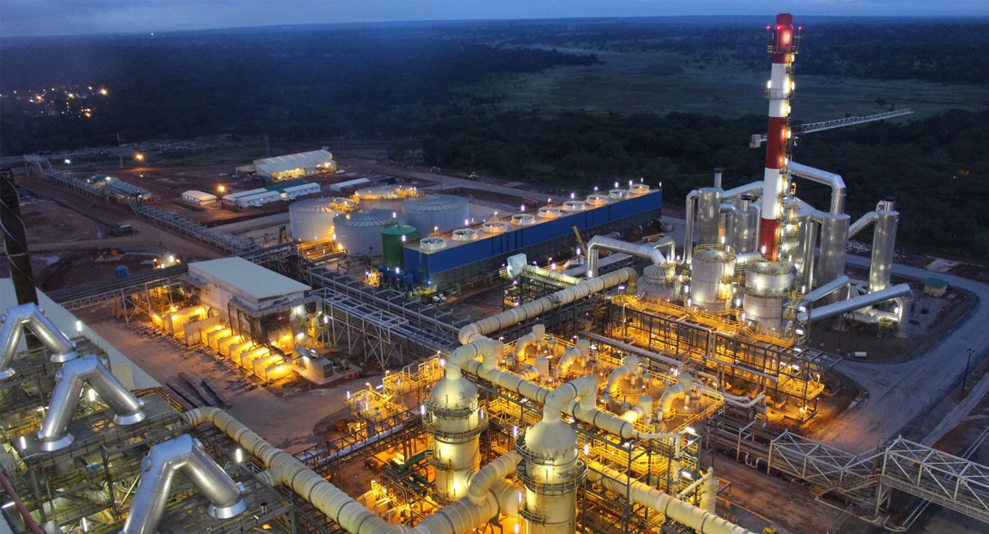
01. STRATEGIC INVESTMENT DEVELOPMENT
.

Slide 5
STRATEGIC OVERVIEW 2020-2026
Extract value from current portfolio.
ZCCM-IH 2020-2026 strategic plan is focused on mining, mining related and energy investments.
ZCCM-IH’s main purpose is to drive the development and growth of the mining sector in Zambia.
One of the Strategic Goals which underpins the company’s strategic impetus, is to invest in greenfield and brownfield mining, and mining related ventures across a diverse range of minerals.
Commodity diversification entails investing in critical minerals to include cobalt, manganese, lithium, copper, and other base metals; gold, gemstones, limestone, phosphate, and rare earth minerals.
Developing alternative revenue streams from the portfolio : Royalty model
Diversify portfolio to reduce risk and enhance returns.
Exploration
Energy projects
Commodity diversification
Mineral value addition projects
Increase shareholder value.
2020 – 2024 Consistent Dividend Payout: ZMW1.6 billion (US$ 75.2 million)
Portfolio Optimization
2020
–
2026
Achieve operational and financial excellence.
Cost optimization
Adopting Best Practices & Systems
High Performance Culture
ESG embedded in all our processes
Notes:
Update dividends with Dollars

Slide 6

CURRENT PORTFOLIO SNAPSHOT
15 Mining Portfolio Companies (% shares)
3 Energy Portfolio Companies (% shares)
4 subsidiaries
New Investments in 2025
Notes:
Add sino great (Highlight)
MSEL
CEC (Mention shareholding)
Show movements in Portfolio by commodity

Slide 7
STRATEGIC DEVELOPMENTS
S3 Expansion Project commissioned in August 2025
As at 31st December 2024, ZCCM-IH (the Company) recorded total royalty of ZMW1,426 million (US$54.51 million)compared to ZMW1,201 million (US$58.48million) in 2023.
Kansanshi Mining Plc
Maamba Solar Energy Limited
Investment in 100 MW solar energy project. ZCCM-IH paid USD 9.45 million for a 35% equity stake. The structure of the transaction is 30% equity and 70% debt
Maamba Energy Limited
ZCCM-IH injected US$ 8.75 million in equity funding towards the 300MW Phase II power plant expansion. The total projected cost is estimated at US$400 million, with the expansion set to double Maamba’s output to 600MW
Copperbelt Energy Corporation Plc
Increased ZCCM-IH shareholding from 31.07% (2023) to 33.51% in 2025 and Renewable Energy Expansion
Revenue for the 6 months up to June 2025 was USD 360million, up from US$ 227.8 million in the same period, signalling impressive growth.
Mingomba Mining Ltd
Continued commitment of funding with USD 10 million cash call completed
Drilled of over 114 Km as of July 2025 as part of exploration program
Commencement of Shaft Sinking in 2026
Konkola Copper Mines Plc
As of July 2025, Vedanta has invested USD385 million of its USD 1.27 billion investment plan by January 2030. KCM is now investing in projects to expand production
KCM produced 43,000 tonnes of finished copper, representing a shortfall of 51% against budget for the period ended 30 June 2025.
KCM is in the process of optimizing operations and targeting 10,000 tonnes of copper cathodes per month by December 2025
Notes:
This slides highlights strategic key developments among others such as
Kansanshi
As of June 2025, royalties from Kansanshi totaled USD 26.1 million. Q3 will see a significant increase in royalties due to copper prices and production
Maamba:
A significant milestone was achieved during the period as Maamba Energy Limited fully settled its historical receivables and, for the first time since the commissioning of the Thermal Power Plant in 2016, declared and paid a dividend of US $17.5million to ZCCM-IH. This accomplishment underscores ZCCM-IH’s long-term strategy of revitalising legacy investments and transforming them into sustainable, dividend-generating assets.
CEC:
Commissioned 34 MW Solar PV plant (Riverside) in Kitwe and commenced with the evacuation of power into the grid.
Commissioned 60MW Itimpi Solar PV Plant.
Issued US$ 200m Green Bond on the LuSE for refinancing existing projects and funding near-term planned projects.
Profit for the period was US$ 61.5 million, up 42.4% from US$ 43.2 million in the same period of 2024, driven by higher revenue and the write-back of USD 10.4 million, a portion of the KCM previously impaired amount.
KCM:
KCM production was affected by smelter issues and acid supply in 2025
This resulted in shortages, as KCM produced43,000 tonnes of finished copper, representing a shortfall of 51% against bud getfor the period ended 30 June 2025.
KCM is in the process of optimizing operations and targeting 10,000 tonnes of copper cathodes per month by December 2025
As of July 2025, Vedanta has invested USD385 million of its USD 1.27 billion investment plan by January 2030.
Key focus areas for KCM is dewatering atKDMP, mine development, improve underground transportation of copper, tailings plant and energy needs including partnership for a 150 MW Solar plant,
Maamba Solar Energy
On 23rd September 2025, Maamba Solar Energy Limited’s(MSEL) 100 MW plant in Sinazongwe District, SouthernProvince was launched and commissioned.
The project, valued at US$ 90 million, is part of MaambaEnergy Limited’s expansion plan to raise its totalgeneration capacity to 700MW by 2026
Total Debt and Equity for the project is US$ 63 million andUS$ 27 million in Equity
ZCCM-IH shall retain 35% (Paid USD 9.45 million in equity) ofMSEL while the remaining 65% will be held by Nava GlobalPTE Limited (previously known as Nava Bharat SingaporePte Ltd).
Subsidiaries: Funding provided to support their recovery plans.

Slide 8
STRATEGIC DEVELOPMENTS
Invested US$ 50 million, comprising of US$ 37.8 million for a 30% equity stake in the project company; and US$ 12.2 million in project debt financing.
Sino Great Chemicals
IRH through Delta Mining its subsidiary has so far invested US$620 million comprised of US$400million to restructure the US$1.7 billion Glencore debt and US$220 million equity investment in Mopani.
Mopani produced 24,337 tonnes of cathode in the first half of 2025 against a budget of 34,481 tonnes. The oxygen plant shutdown in Q1 2025 impacted production
Mopani Copper Mines Plc
CNMC Luanshya Copper Mines
Dewatering project underway. The project is estimated to cost a total of USD 750million and will extend the LOM by 20 years
Production expected to increase with an additional 45, 000 MTP
Lubambe Copper Mines Limited
Lubambe is undergoing a turnaround strategy aimed at stabilizing production, optimizing operations, and extending the mine life. The company expects further investment in mine development and infrastructure to unlock its long-term value.
NFCA is working on Phase II of the SEOB project estimated to cost about US$700million and will result in an increase in the annual production capacity from 90,000 to 110,000 tonnes copper contained.
NFCA Africa
Support turn around plans (Kariba Minerals, Limestone Resources and Zambia Gold) to support their turnaround plans.
Divestments in key asset to focus on mining, mining related and Energy (Investrust, Misenge, Consolidated Gold, Mushe Milling and Rembrandt)
Other Investments Optimisation
Notes:
This slides highlights strategic key developments among others such as
NFCA
As of June 2025, NFCA produced 38,660tonnes of copper but on course attain annual budget of 79,000 tonnes
Mingomba: Exploration progressing well—key for future critical minerals.
Sino Great
The integrated project will include paphosphate mine, a 300,000tonnes per annum Monoammonium Phosphate (MAP)plant, and a 40 MW thermal power plant.
CNMC
•Production as of June 2025 was 23,679 and on course to attain annual production 46,000
ZGC
ZCCM-IH contributed USD 5 million in July 2024 as a shareholder loan to ensure the reopening of the Kasenseli mine (now Kamunshinshi) as well as other operations
The official reopening of Kamunshinshi by his Excellence President Hakainde Hichilema was held on 17thNovember 2024.
Production resumed accordingly inQ1 2025 including gold trading in key areas such as Rufunsa and Mumbwa
Subsidiaries: Funding provided to support their recovery plans.

Slide 9
02. FINANCIAL PERFORMANCE HIGHLIGHTS
.

Slide 10
SIX YEAR PERFORMANCE ANALYSIS 2020 – 2025 HY
2024 and 2025: Transformational Years
EPS rose to ZMW 247.80, marking a strong rebound from prior-year losses.
2025 half year experienced lower EPS of negative ZMW 1.23 in the absence of the one-off exceptional investment gain realised from the Mopani Strategic equity partner
NAV per share surged to ZMW 325.02, signalling significant shareholder value creation. This increased further to ZMW 411 in the first half of 2025
2020–2023: A Period of Financial Strain
Losses were driven by legacy assets, the Glencore loan, and recurring impairments.
2023 recorded negative equity, indicating financial distress, with liabilities exceeding assets.
Performance was marked by low ROA and limited liquidity amid operational restructuring
Notes:
Say : Ladies and Gentlemen , this slide illustrates our six-year financial journey from 2019 to 2024.
Over the past six years, ZCCM-IH has undergone a clear transformation. Between 2020 and 2023, performance was weighed down by legacy asset impairments, the Glencore loan, and limited liquidity, with 2023 marking the lowest point as the Group recorded negative equity. However, 2024 became a turning point, driven by the Mopani Strategic Equity Partner transaction, which delivered exceptional gains and a record EPS of ZMW 247.80. Although 2025 half-year results show a modest loss of ZMW 852.86 million due to the absence of that one-off gain, underlying operations are stabilizing, and the balance sheet remains strong with equity above ZMW 52 billion. NAV per share continues to rise, reaching ZMW 411 in 2025 HY, reflecting renewed investor confidence and shareholder value creation.

Slide 11
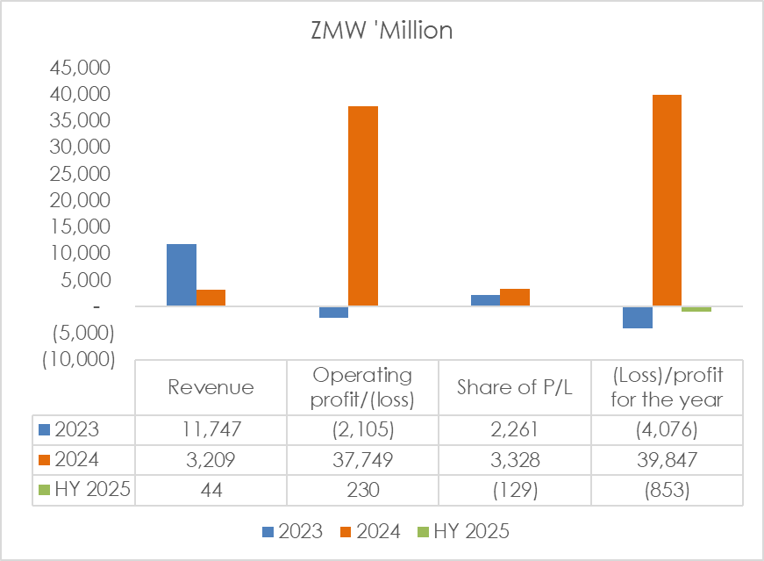
FINANCIAL HIGHLIGHTS – GROUP INCOME STATEMENT
The Group posted a net loss of ZMW 852.86 million (US$31.25 million) compared to a profit of ZMW39.85 billion (US$1.52 billion) in 2024 was on account of the following :
The absence of the one-off gain from the Mopani Strategic Equity Partner transaction in 2024.
Mopani and KCM underperformed during the period. Both companies have since embarked on strategic initiatives to increase production and generate sustainable incomes.
The appreciation of the Kwacha against the US Dollar also reduced foreign currency earnings and asset values.
Notes:
The Group recorded a half-year loss of ZMW 852.86 million compared to a 2024 profit of ZMW 39.85 billion mainly because the exceptional Mopani gain was not repeated.
Mopani and KCM underperformed but are now focused on ramping up production and building sustainable income.
The Kwacha’s appreciation reduced USD earnings and asset values.

Slide 12

FINANCIAL HIGHLIGHTS – GROUP FINANCIAL POSITION
 | FY 2023 | FY 2024 | HY 2025
Assets | ZMW millions | ZMW millions | ZMW millions
Non-current assets | 29,649 | 50,644 | 50,967
Current assets | 28,815 | 6,642 | 4,867
Total assets | 58,464 | 57,286 | 55,834
Equity and reserves | (5,691) | 52,264 | 52,336
Non-current liabilities | 882 | 3,368 | 2,807
Current liabilities | 63,273 | 1,654 | 691
Total equity and liabilities | 58,464 | 57,286 | 55,834
The Group total assets decreased to ZMW55.83 billion (US$ 2.33 billion) from ZMW57.29 billion (US$ 2.05 billion), the 3% decrease was mainly due to lower trade receivables and short-term deposits.
The stronger Kwacha and revaluation of foreign currency assets also contributed to the decline.
Notes:
Say : This slide is showing the Group level financial position results, the 3% decrease in Group total assets is mainly due to the decrease trade and other receivables, and short-term deposits. The appreciation of the Kwacha and the revaluation of foreign-currency denominated assets also contributed to the decrease in the total assets. The Group total assets decreased from ZMW57.29 billion (US$ 2.05 billion) in 2024 to ZMW55.83 billion (US$ 2.33 billion).

Slide 13
FINANCIAL HIGHLIGHTS – INVESTMENT IN ASSOCIATE ANALYSIS 2025
 | FY 2023 |  | FY 2024 |  | HY 2025
Investee Company Name | Profit/(loss) | Share of profit/(loss) | Profit/(loss) | Share of profit/(loss) | Profit/(loss) | Share of profit/(loss)
 | ZMW’Million | ZMW’Million | ZMW’Million | ZMW’Million | ZMW’Million | ZMW’Million
Konkola Copper Mines Plc | - | - | 12,153 | 2,503 | (2,516) | (518)
Mopani Copper Mines Plc | - | - | (3,490) | (1,710) | (2,100) | (1,029)
Copperbelt Energy Corporation Plc | 2,825 | 878 | 2,535 | 823 | 1,679 | 554
CNMC Luanshya Copper Mine Plc | 2,929 | 586 | 3,917 | 783 | 2,176 | 435
Maamba Collieries Limited | 2,566 | 898 | 3,072 | 1,075 | 1,758 | 615
Lubambe Copper Mines Limited | (3,055) | - | (2,707) | - | (2,824) | -
Rembrandt Properties Limited | (2) | (1)
Mingomba Mining Limited | (497) | (99) | (728) | (146) | (768) | (154)
Sino Great Chemical Company Limited | - | - | - | - | (106) | (32)
Total | 4,766 | 2,262 | 14,752 | 3,328 | (2,701) | (129)
USD$' million | 232 | 110 | 564 | 127 | (201) | (10)
The significant decrease in the share of profit recorded during the half year of 2025 is due to KCM, Mopani and Lubambe which are having operational reforms involving recapitalization and ramping up production aimed at unlocking their full potential. The current performance of KCM, Mopani and Lubambe remains below capacity.
Investing SMARTLY
Notes:
This slide provides an analysis of ZCCM-IH’s investments in associates performance . At Group level, the share of profit declined from ZMW 3.33 billion in 2024 to a loss of ZMW 2.7 billion in the first half of 2025. Losses from KCM, Mopani, and Lubambe offset positive contributions from CNMC, Maamba, and CEC.
It is important to note that KCM, Mopani, and Lubambe are currently undergoing operational reforms, including recapitalization and production ramp-up initiatives aimed at unlocking their full potential. Although their current performance remains below capacity, these measures form part of our long-term growth and recovery strategy.

Slide 14
ZCCM-IH SHAREHOLDER DIVIDEND PAYMENTS
FY | DIVIDEND PER SHARE | TOTAL DIVIDEND PAYOUT | DIVIDEND YIELD
2024 | K3.29 per share​ | K528 million ($22.9m)​ | 5.02% (Share Price - K65.00)​
2023 | K1.51 per share | K243 million ($11.0m) | 3.6% (Share Price - K42.00)
2022 | K2.41 per share | K387 million ($19.7m) | 6.34% (Share Price - K37.98)
2021 | K2.09 per share | K336 million ($17.1m) | 5.5% (Share Price K37.98)
2020 | K0.53 per share | K 85.2 million ($4.5m) | 1.86% (Share Price of K28.47)
*Dividend Yield calculated as percentage of the Lusaka Securities Exchange Closing Share Price
ZCCM-IH has consistently paid dividends from 2020 to 2024
Notes:
This slide highlights that ZCCM-IH has consistently paid dividends from 2020 to 2024, underscoring our firm commitment to creating and sustaining shareholder value.
This concludes my presentation on the 2025 financial highlights
I now have the pleasure of inviting the Chief Executive Officer to present the strategic focus for the Group. Thank you

Slide 15
03. STRATEGIC OUTLOOK
.

Slide 16
STRATEGIC ETHOS
FOCUSED
EXPAND
SUSTAIN
The ZCCM-IH strategic ethos is anchored on pursuing a mining focused investment strategy that is premised on growth and innovation, with the clear intent to drive the company to financial excellence and return optimisation.
ZCCM-IH intends to develop the mining sector across the value chain and reduce dependency on copper through commodity diversification into other minerals and revenue streams for the benefit of the company and the country at large.
Maximising value from both greenfield and brownfield projects in a sustainable manner underpins our investments.

Slide 17
VALUE EXTRACTION STRATEGIES
MOPANI | Negotiate marketing rights and dividends
NFCA &CNMC | Negotiate marketing rights, royalties and dividends
Lubambe | Value extraction strategies such as royalties and marketing rights
Subsidiaries (Kabundi, Kariba Minerals, Zambia Gold, Limestone Resources) | Portfolio optimization including recapitlization
Energy | ZCCM-IH’s Planned Solar Projects Target: 350 MW in 12 to 18 months
Metals Trading | Commercial Unit set up to purchase Gold and Manganese
Investing SMARTLY

Slide 18
EXPLORATION PROJECTS
Rufunsa Gold Exploration and Mining Licence
Kabundi Exploration – manganese and copper exploration
Exploration of 9 minerals and 9 Oil and gas licenses
ZCCM-IH licences
Zambia Gold Company: Kasenseli Gold Exploration Project
Kabundi Resources: Manganese mining and Exploration
Kariba Minerals: Amethyst
EXPLORATION
PRIORITIES
Licences owned by subsidiaries
Joint exploration partnerships
Outright purchase depending on stage of exploration and valuation
Third party licences
Investing SMARTLY
Notes:
Under exploration, undertaking this will require partnerships as a way of managing risk and cost. The potential partner will have to meet pre-set criteria including Technical and financial competences among others.
Minerals being targeted for this venture include Base Metals (copper, cobalt), Precious Metals/Minerals & gemstones (gold, amethyst) and Industrial Minerals (manganese). Licences being targeted include own licences, subsidiary licences and third party licences, and as shown here the respective attendant strategies.

Slide 19
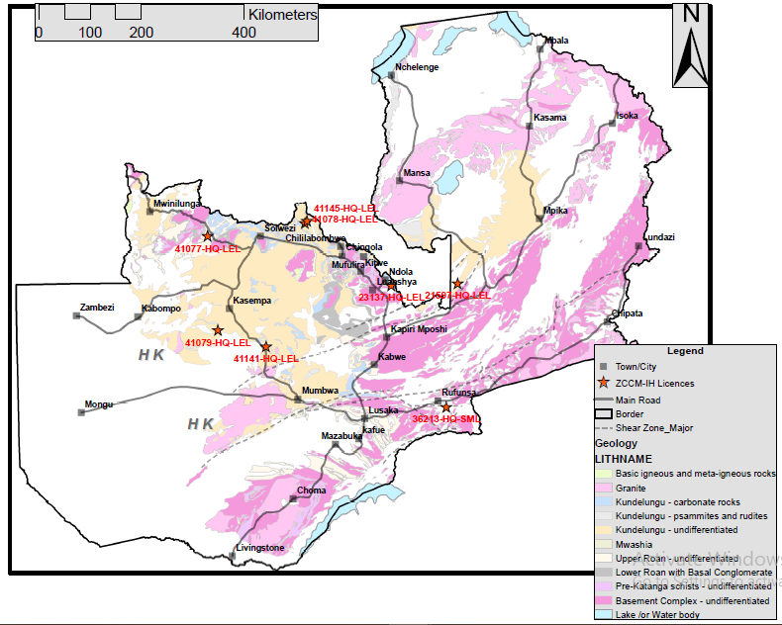
Exploration Projects-Minerals
No. | Locality | District
1.0 | Kabundi | Serenje
2.0 | Kamwesha | Rufunsa
3.0 | Ndola | Masaiti
4.0 | Lumwana | Kalumbila
5.0 | Kipushi | Mushindamo
6.0 | Kipushi | Mushindamo
7.0 | Kamuzekezeke | Kasempa
8.0 | Chifumpa | Kasempa
9.0 | Kikonge | Mfumbwe
5
6
4
9
3
1
7
8
2

Slide 20
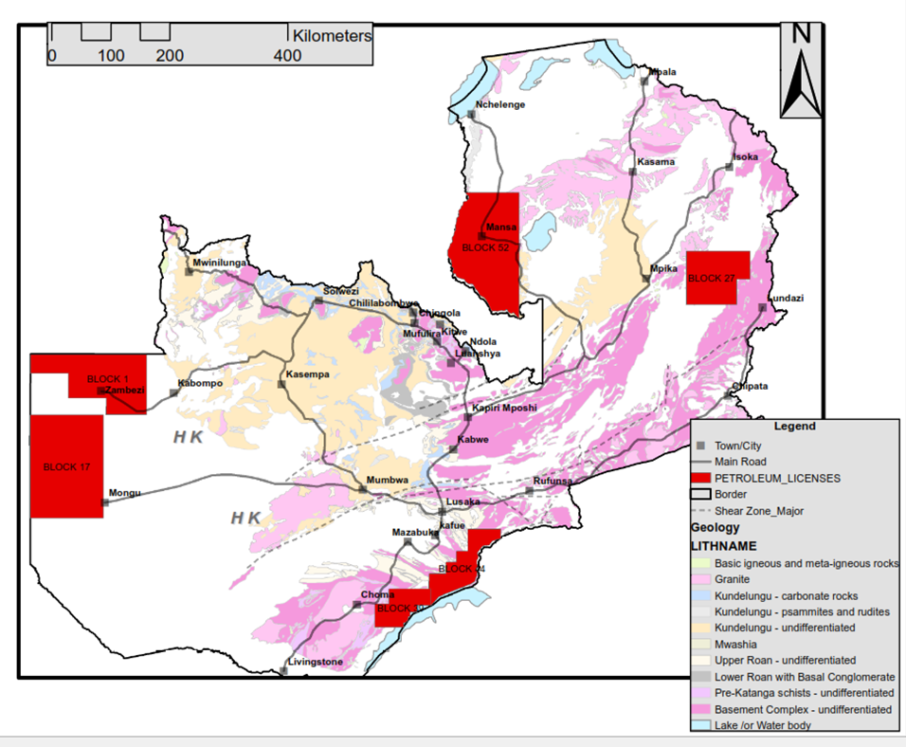
ZCCM-IH Oil and Gas Licenses (Exploration)
No. | Locality
1.0 | Chavuma
2.0 | Mansa/Milenge/ Mwense/Luwingu
3.0 | Choma/Gwembe/Sinazongwe/ Siavonga
4.0 | Siavonga/ Chirundu
5.0 | Chavuma/ Zambezi/Mongu
6.0 | Mpika/Chama/ Chinsali/Lundazi
7.0 | Chavuma
8.0 | Mansa/Milenge/ Mwense/Luwingu
9.0 | Choma/Gwembe/Sinazongwe/ Siavonga
2
6
8
1
7
5
4
3
9

Slide 21
04. CORPORATE ACTIONS
.

Slide 22
LISTING OPTIMISATION: STATUS UPDATE
The Advisors, Stockbrokers Zambia and Bowsprit finalized the Listing Optimization Report and submitted the report to Management and the Board for Approval. The following are the next steps:
Amendment of Articles of Association
Commencement of Optimisation Implementation Steps
Board presentation of Corporate Action proposal to the Shareholders for review and approval via an EGM
Implementation of what shareholders will approve

Slide 23
Thank You
Questions?

Slide 24
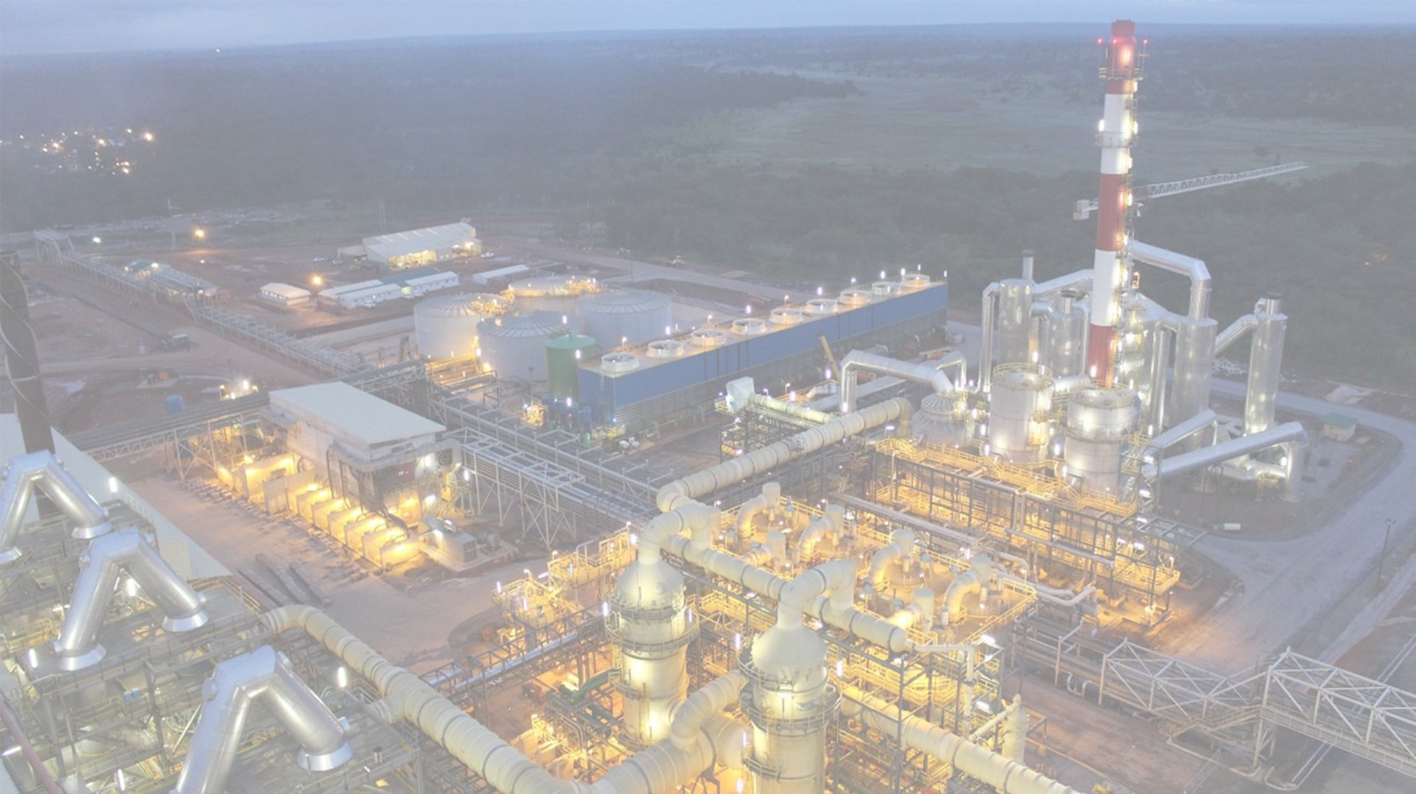

Presentation by
STOCKBROKERS ZAMBIA LIMITED
_______________________________
STOCK MARKET PERFORMANCE
2020-2025
_____________________________________
Licensed Dealer and Founder Member of the Lusaka Stock Exchange
Regulated by the Securities & Exchange Commission of Zambia

Slide 25
SHARE PRICE EVOLUTION SINCE 2020
Share prices from January 2020 to September 2025
Share prices converted from Kwacha and Euro into Dollar at the prevailing exchange rate.
Dotted lines show when dividends were paid by ZCCM-IH.
Year To Date % Growth
  LuSE- 257%
  Euronext- 84%
Data Sources
Share price data from investing.com and LuSE
Exchange rate data from European Central Bank and Bank Of Zambia
Notes:
Historically, there has been an arbitrage in the share prices of Euronext and LuSE with the LuSE share price being higher than on the Euronext. Despite the arbitrage, we see similar movements in the share price.
2025 has seen a big appreciation in the share price which will go into in the next slide

Slide 26
SHARE PRICE - YTD 2025
Share prices from January 2025 to September 2025
Share prices converted from Kwacha and Euro into dollar at prevailing exchange rate on the day.
Dotted lines show when dividends were paid by ZCCM-IH.
Solid line show when financial results were published
Year To Date % Growth
  LuSE- 206%
  Euronext- 56%
Data Sources
Share price data from investing.com and LuSE
Exchange rate data from European Central Bank and Bank Of ZambiA
Notes:
2025 has seen the highest appreciation in the share price since 2020.
We see from the green line that the appreciation really started around the publishing of the provisional abridged financial results on 6 May. The results showed a much improved position in earnings and equity. These results were backed by the audited abridged results released on 20 June
The AGM on 18 July where a dividend was declared and approved only reinforced the trend of the increase in the share price.

Slide 27
SHARE PRICE - LSE YTD 2025
No trading activity was recorded in 2025
Data Sources
Share price data from investing.com and LuSE
Exchange rate data from European Central Bank and Bank Of ZambiA

Slide 28
INDEXED ZCCM-IH SHARE PRICE RELATIVE TO ECONOMIC BENCHMARKS
The chart compares the ZCCM-IH share price to three other metrics on a relative basis.
LuSE All Share Index
Zambia Consumer Price Index (Inflation)
ZMW-US$ Foreign Exchange
All of these metrics were indexed to the January 2020 values and then charted over the period.
Data Sources
Share price data from LuSE
Exchange rate data from Bank Of Zambia
Inflation data from Zambia Statistics office and Bank of Zambia
Notes:
This chart shows the benefits of investing in ZCCM-IH versus selected economic benchmarks. We can see from the graph that an investment in ZCCM-IH would have provided a return greater than inflation and the movement in the kwacha dollar exchange rate. Relative to the USD/ ZMW exchange rate, we note that the ZCCM-IH share price provides capital preservation.

Slide 29
VOLUMES TRADED – YTD 2025
Chart shows volume traded of ZCCM-IH from both Euronext and LuSE.
Data Sources
Volume data from Euronext and LuSE
Notes:
Retail trading drives activity and share price on both LuSE and Euronext . Volumes traded on the LuSE are thin compared to Euronext . This is because the LuSE has fewer retail investors and volumes held under its CSD compared to Euronext

Slide 30
EURONEXT TRAILING PE & PBV RATIOS - 2020 TO 2025
Chart shows 1-year trailing PE and PBV of ZCCM-IH based on LuSE share price from 2020-2025.
Data Sources
Share price data from investing.com
Financial data from ZCCM-IH annual reports
Notes:
PE and PBV are traditional metrics for indicating and comparing valuation of companies on the stock market. We see from the graph that ZCCM-IH has had relatively low values being below 1 for the last 4 years

Slide 31
DISCLAIMER
This document is intended for discussion purposes only and does not create any legally binding obligations. It does not purport to contain all of the information that may be required to evaluate any potential transaction and should not be relied on in connection with any such potential transaction.
This document is confidential and should not be copied, distributed, published or reproduced, in whole or in part, or disclosed to any other person.
The information contained in this document was either obtained from the Company or from publicly available sources and has not been independently verified by Stockbrokers Zambia. Stockbrokers Zambia does not make any representation or warranty, express or implied, as to the accuracy or completeness of the information contained in this document.
Any liability in respect of this document (including in respect of direct, indirect or consequential loss or damage) is expressly disclaimed.
Stockbrokers Zambia does not provide legal, accounting or tax advice and for such advice you agree to consult your own independent advisors on any legal, tax or accounting issues relating to these materials.
Nothing herein shall constitute a commitment to purchase, underwrite or arrange any offering of securities or commit to any financing transaction; any such commitment will only be as set out in mutually agreed legal documentation.
The authors will not incur any liability for any loss arising from any use of this document or its contents or otherwise arising in connection therewith. Neither will the sources of information or any other related parties be held responsible for any form of action that is taken as a result of the proliferation of this document.
Stockbrokers Zambia Ltd (“SBZ”) is authorised and regulated by the Securities Exchange (“SEC”) of Zambia and is subject to its rules.
Stockbrokers is not acting as your financial adviser or in any other fiduciary capacity and you shall not be treated as a client of SBZ or be entitled to the protections afforded to clients.

Slide 32
Thank You
Questions?

